Slide 1
Data Analysis Final Project: Disease Prediction
team – code blue
Frank Sullivan, jade bible, john setzer,
morgan behr, summer bell

Slide 2
Disease Prediction using Machine Learning
Reason Why the Topic was Selected
Developing a model where a list of symptoms can be input to make disease predictions can help diagnosing diseases faster
Description of the Data Source
The data used is two csv files downloaded from Kaggle.
The dataset utilized from a csv testing and csv training file.
The source of the data from the author is not disclosed.

Slide 3

Disease Prediction using Machine Learning
Questions We Hope to Answer with the Data
1. Can our machine learning model be used to predict the correct disease based on symptoms entered?
2. How many symptoms need to be present to increase the accuracy of the model?

Slide 4

Technologies and Languages
Jupyter Notebook
Python
Pandas
MatPlotLib
tkinter
pgAdmin
PostgreSQL
Tableau
Notes:
To develop our disease prediction machine learning model required the use of multiple technologies and programming languages. We used Jupyter Notebook to write Python code for both data preprocessing and our machine learning model. A SQL database was created with pgAdmin. A Tableau storyboard was developed for interactive data visualizations. The following slides will provide detailed explanations of how each technology was used.

Slide 5
Dashboard
Interactive storyboard created in Tableau
Follow the link below:
https://public.tableau.com/app/profile/jade3140/viz/DiseasePredictionProject/DiseasePredictionData?publish=yes
Notes:
We have a fully functioning and interactive dashboard in Tableau. Our analysis will be displayed with a storyboard that provides clear data visualizations. Follow the link to see the charts and graphs that show insightful relationships in our data and images of our analysis.

Slide 6
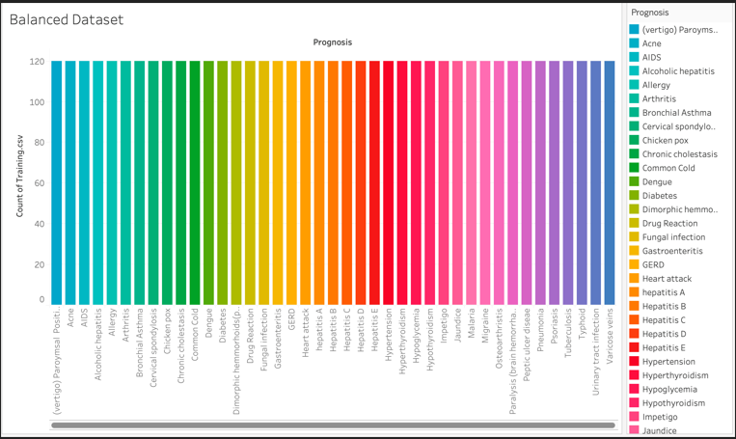
Dashboard - Charts
Balanced Dataset
Notes:
This chart displays our balanced dataset.
The absence of a symptom can be as important as the presence of a symptom.
This shows that each prognosis has a complete dataset.

Slide 7
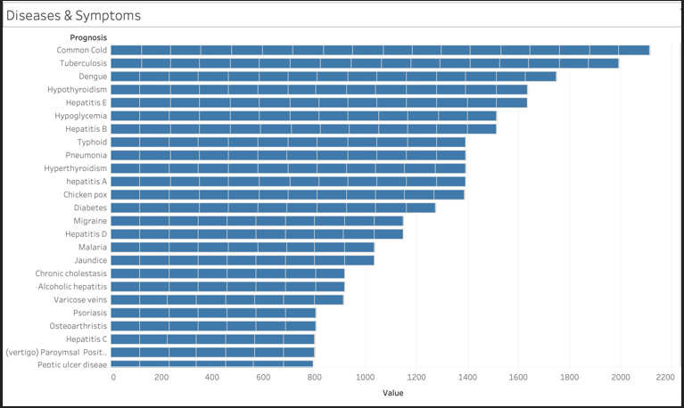
Dashboard - Charts
Diseases & Symptoms
Notes:
This visualization displays which prognosis have the most symptom frequency.

Slide 8
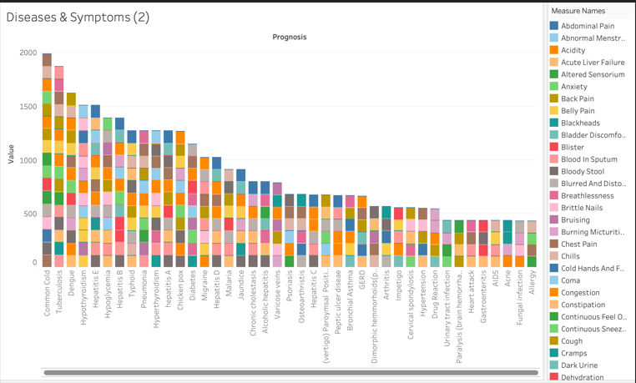
Dashboard - Charts
Diseases & Symptoms
Notes:
In tableau this interactive chart allows us to select a symptom and easily see based off color how many diseases have it.

Slide 9

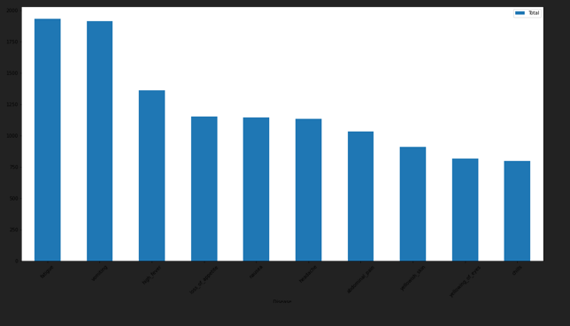



MatPlotLib Graph – Top Ten Symptoms

Slide 10
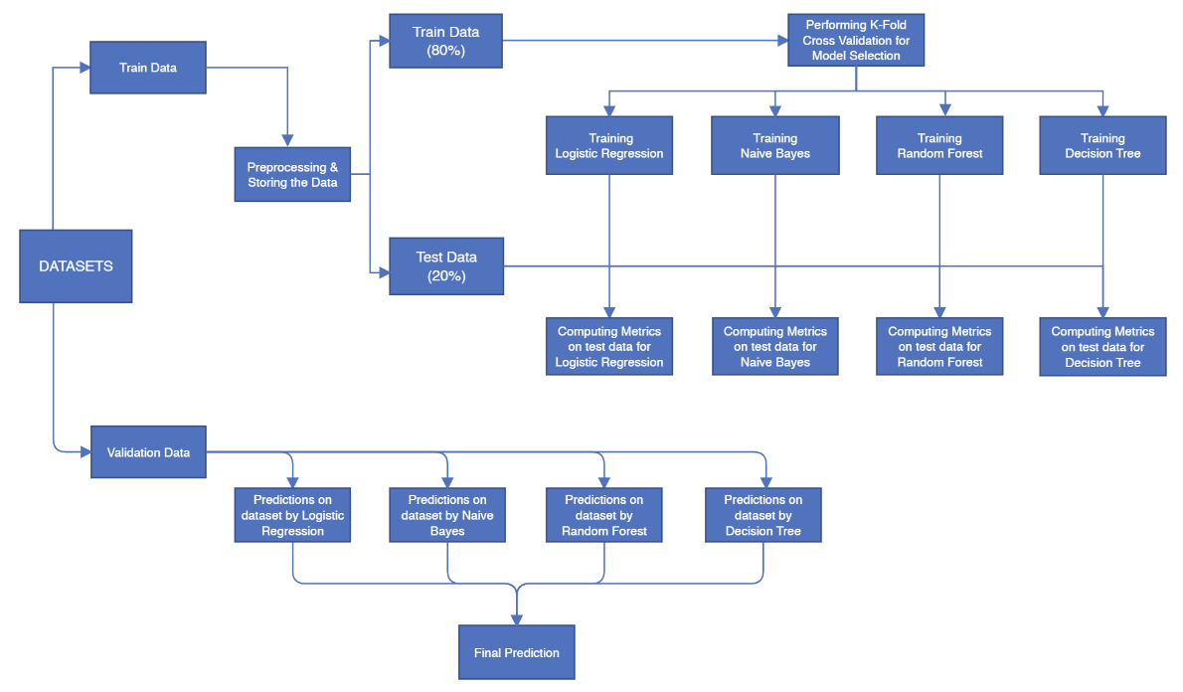
Project Model Flow Chart

Slide 11
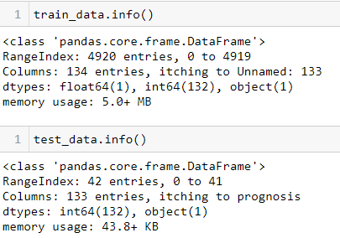
Data Exploration Phase
Preprocessing Data
Data Types evaluated
train_data.info()
test_data.info()
train_data.describe()
test_data.describe()
Null values removed
train_data.isnull().any()
train_data.drop(["Unnamed: 133"], axis=1, inplace=True)
Notes:
To begin the preprocessing the two CSV datasets were imported and assigned as to variables train_data and test_test. A key part of the data exploration phase is preprocessing the data. This allows us to learn about the data characteristics and identify potential problems. We used the pandas info and describe functions to explore the data. For the model to function correctly all data in both data sets has to be in the correct data type. We also needed to isolate columns with null data and drop that data. The isnull with any functions identified the null values then the drop function was used to remove it from the data frame.

Slide 12
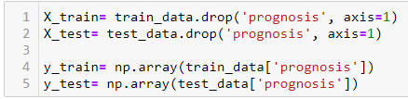
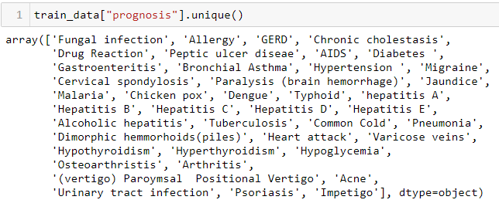
Training and Testing Data
Remove target from Features Data
Create Target (Dependent Variable)
Notes:
Machine learning utilizes both training and testing data.
Our data set downloaded from Kaggle was already split into training and testing csv files.
The training data is necessary to teach the machine learning algorithms.
The testing data helps validate the accuracy of the algorithm’s training.
To prepare the data for the machine learning models we created target and removed it from the features data.

Slide 13
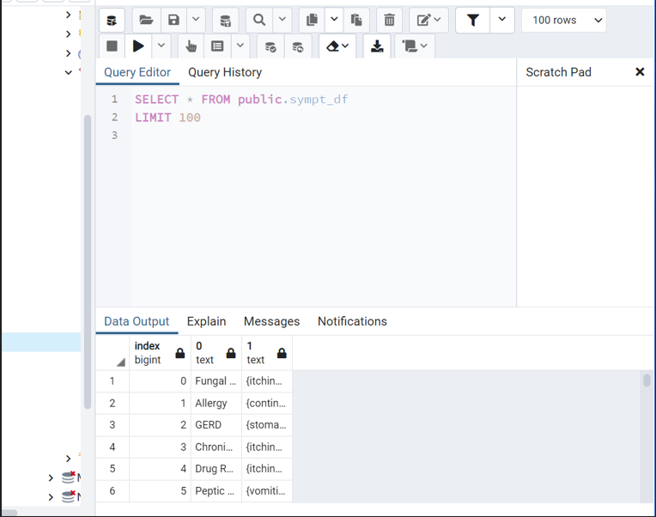
Database – pgAdmin – Symptoms Dataframe
3 Tables:
Sypt_df
Train_data
Test_data
Notes:
The preprocessed train_data, test_data and sympt_df data sets were exported into PostgresSQL as three separate tables.
This created a static database in pgAdmin for use throughout the project.
There is a detailed ERD the displays the relationships.
A join was performed on the tables.
The database interfaces with [Disease_Prediction_ML.ipynb](Disease_Prediction_ML.ipynb).
Using ‘from sqlalchemy import create_engine’ the PostgresSQL data is used in our machine learning model.

Slide 14
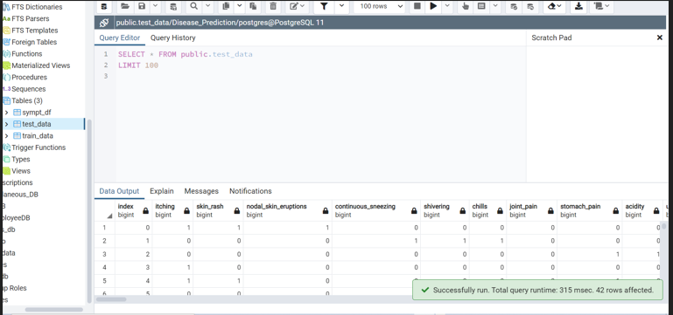
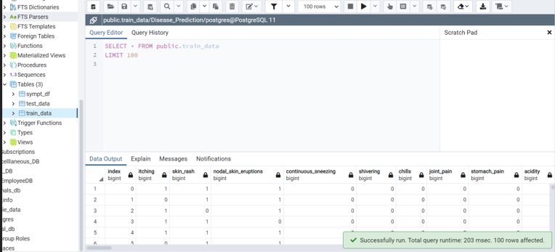
Database – pgAdmin - Test and Train Tables

Slide 15
Data Analysis Phase
Supervised Learning Models:
Logistic Regression
Decision Tree
Random Forest
Naïve Bayes
Notes:
With a clean data set the data analysis phase can begin.
There are many modeling techniques that can be used to analyze data.
Supervised learning models use labeled input and output data.
We choose 4 supervised learning models: logistic regression, decision tree, random forest and naïve bayes.

Slide 16
Machine Learning – Supervised Learning Models
Linear Regression
Benefits
Good for binary datasets
Less inclined to overfit
Limitations
Requires a large sample size
Decision Tree
Benefits
Less data preparation effort
Intuitive and easy to explain
Limitations
Small changes in data can cause large changes in structure
More significant model training time
Notes:
Our binary dataset is optimal for a logistical regression model.
A machine learning logistical regression algorithm can be used to predict the outcome of dependent variables based on training data.
It uses a combination of input variables to predict the probability of the input data belonging to categories.
Decision tress are among the most powerful supervised learning algorithms

Slide 17
Machine Learning – Supervised Learning Models
Random Forest
Benefits
Reduced chance of overfitting
Primarily used for classification
Flexible and possess high accuracy
Work well for a large range of data items
Limitations
Complexity
Time consuming
Naïve Bayes
Benefits
Straight-forward algorithm
Low risk of overfitting
Limitations
Not ideal for data with complex features
Biased nature
Notes:
The random forest algorithm creates decision tress on data samples and then gets the prediction from each of them and finally selects the best solution by means of voting

Slide 18
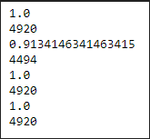
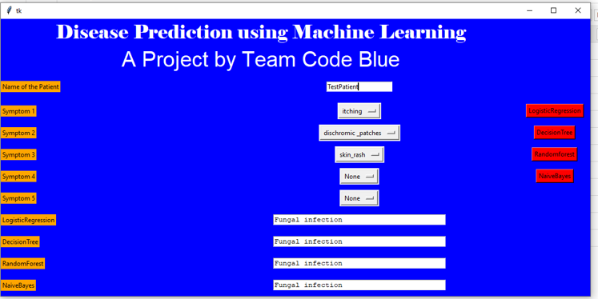
Machine Learning - Test Patient 1
Accuracy Score:
GUI:

Slide 19
Conclusion
1. Can our machine learning model be used to predict the correct disease based on symptoms entered?
Yes
2. How many symptoms need to be present to increase the accuracy of the model?
The top ten frequent symptoms required more symptoms input to increase accuracy of diagnosis.

Slide 20
Questions

